Slide 1
World History Fall Final
Ancient History to
the American Revolution

Slide 2
Prehistoric means before ____?
Writing
Then how do we know about prehistoric people and what they did?

Slide 3
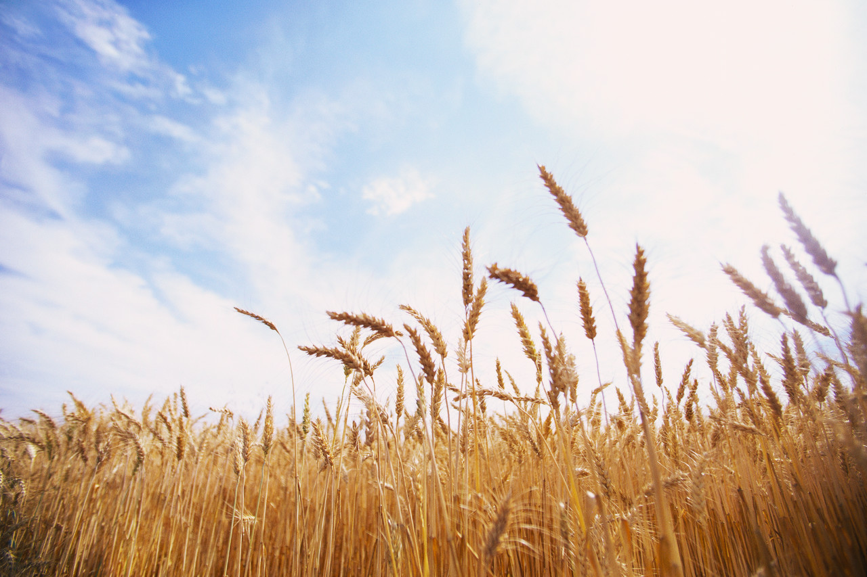
In the Old Stone Age they hadn’t figured out how to raise their own crops, so they were known as ______?
NOMADS

Slide 4
Everyone starts to specialize their labor
So they start the barter economy
Set up new laws to deal with people
And warfare starts between the settlements.

Slide 5
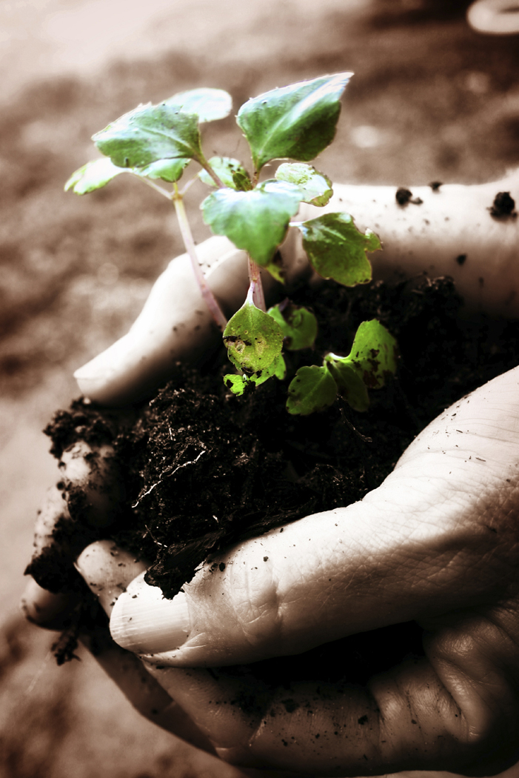
Why do ancient civilizations settle near the river valleys?

Slide 6
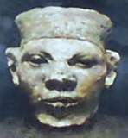
King Menes has a powerful family

Slide 7
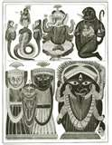
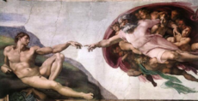
Ancient Religions
VS.
HEBREWS

Slide 8
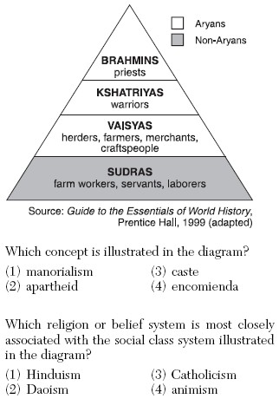
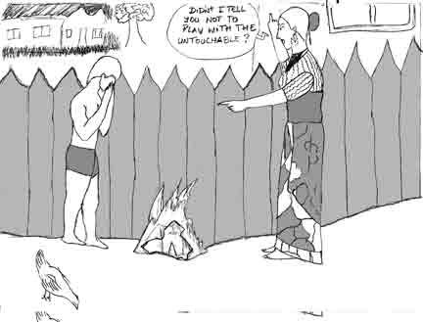

Slide 9
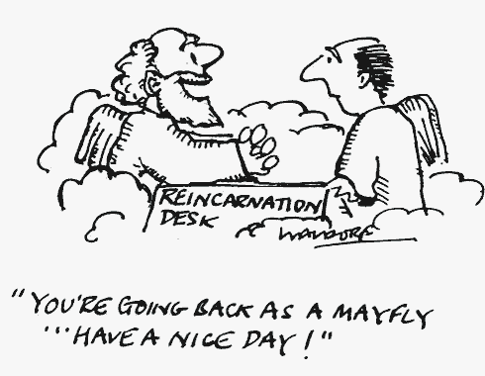
Which religion believes in reincarnation?

Slide 10
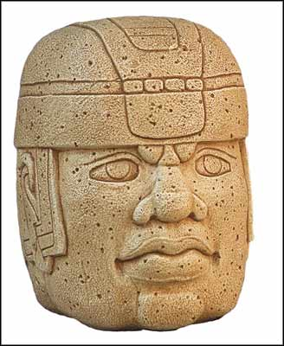
Olmecs in the Americas
Around 6,000 BC the first cultures began to emerge. The first were the Olmecs which began around 1500 BC and died out around 200 AD. They were known for the Olmec heads. 16 of them are at the Museum of Anthropology in Xalpa.

Slide 11
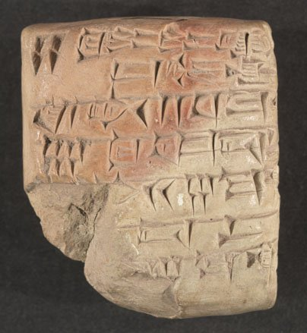
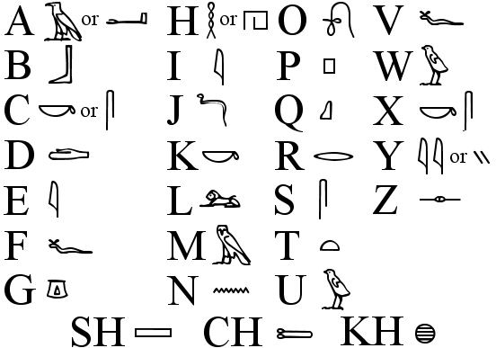
Hieroglyphics – organized writing mostly Egyptian
Cuneiform writing – reeds pressed into clay
Babylonian – Way pickin’ old
2300- 800 BC

Slide 12
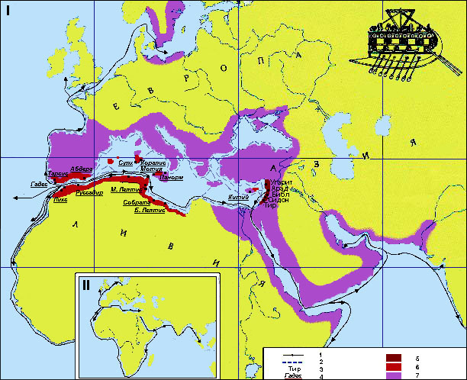
Phoenicians were good traders

Slide 13
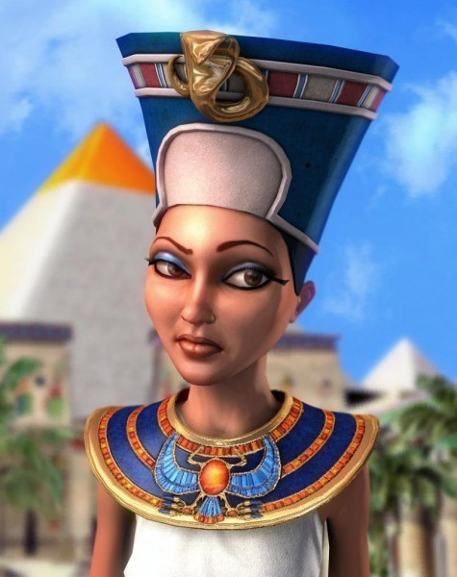
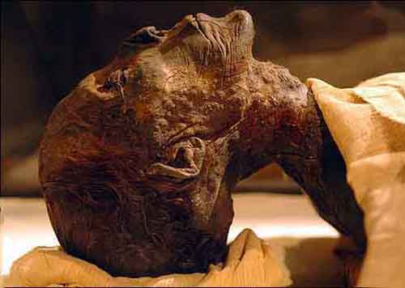
Hatshepsut- Egyptian queen 1503-1482BC

Slide 14
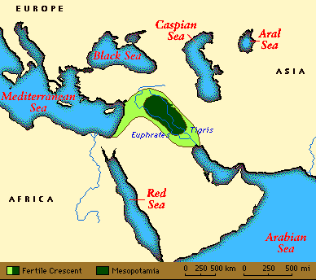
Mesopotamia
Means the land between the rivers
Which rivers?

Slide 15
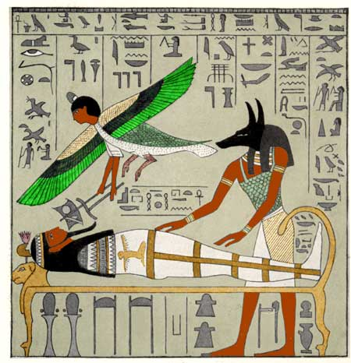
The Afterlife !!!!

Slide 16
Match the vocabulary
Bureaucracy
Shogun
Missionaries
Calligraphy
aborigines
Held greater power than the emperor of Japan
A cultural contribution of the Chinese
Came to Australia from Asia
The Khmer empire borrowed this idea from India
The way through which Asoka’s peaceful ideas were spread from India to other regions

Slide 17
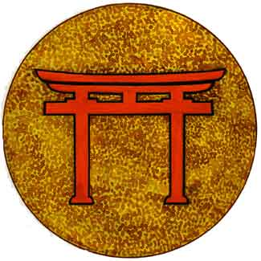
SHINTO
Japanese take a lot of Chinese ideas like script writing,
their form of government and even Buddhism. They
merged their beliefs with Buddha’s and created Shinto.

Slide 18
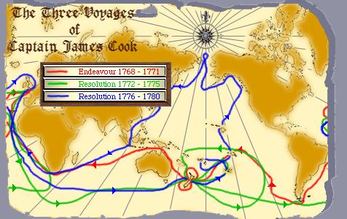
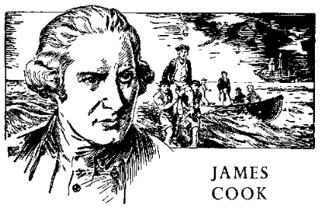
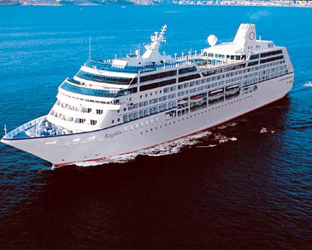

Slide 19
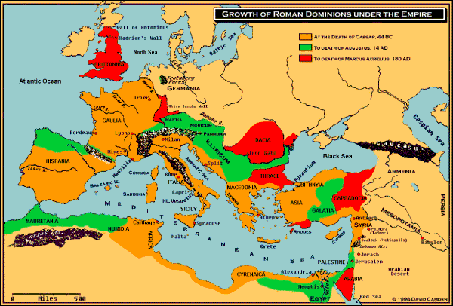
The Roman Empire
The Empire falls because they’re starving
They’re selfish and think they’re all that
Inflation is a killer
Other tribes start to raid due to weaknesses

Slide 20
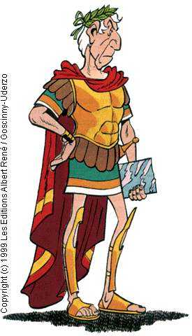
Julius Caesar
Was a salad?
Was the last emperor of Rome?
Was a great military leader?
Was made dictator for life?
Was really popular after being made dictator---NOT!

Slide 21
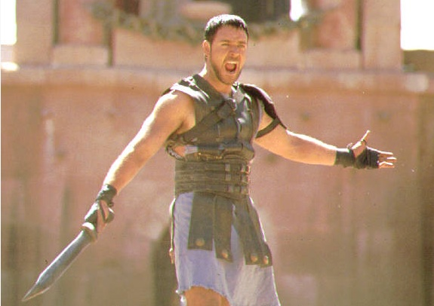
WOW THIS IS REALLY ENTERTAINING!!! OH WAIT YOU’RE DEAD. WELL I’M A GLADIATOR WHAT DO YOU EXPECT.

Slide 22
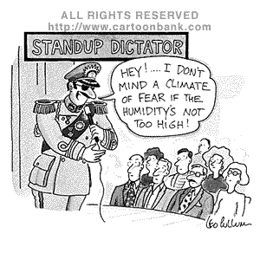
DICTATOR
SUCH WARM AND FUZZY TERM
A PERSON WHO RULES A NATION WITH ABSOLUTE POWER

Slide 23

REPUBLIC
POWER TO THE PEOPLE
A REPBULIC – POWER RESTS IN THE HANDS OF THE CITIZENS WHO ELECT A GROUP OF PEOPLE TO REPRESENT THEM IN GOVERNMENT

Slide 24
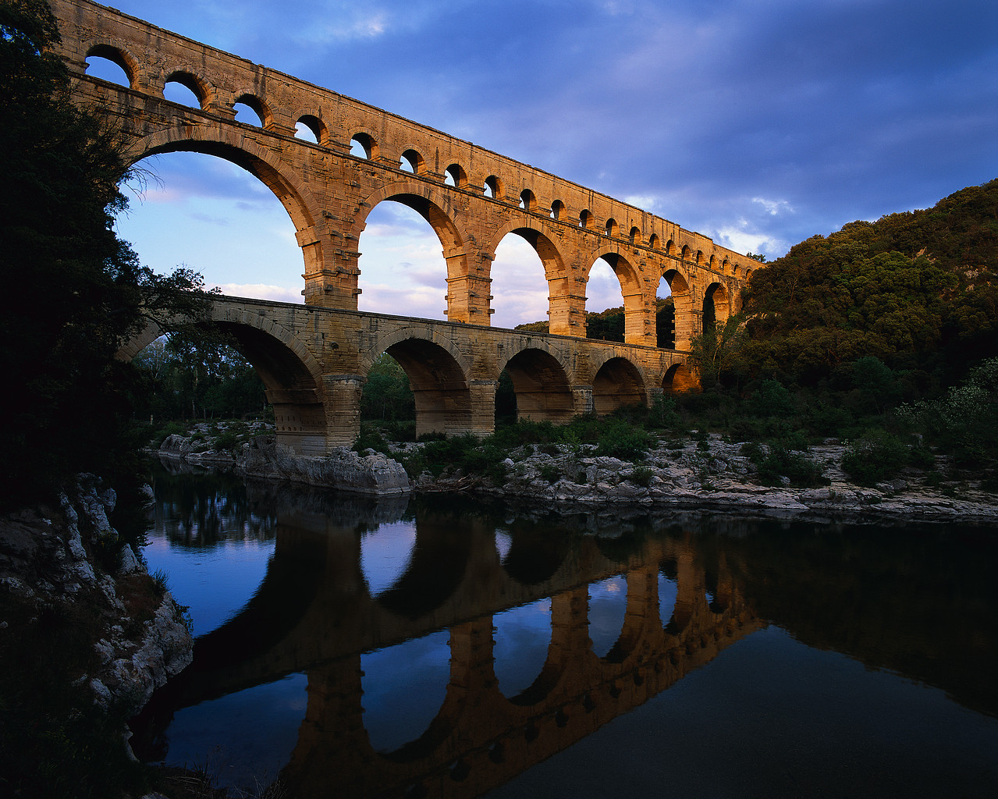
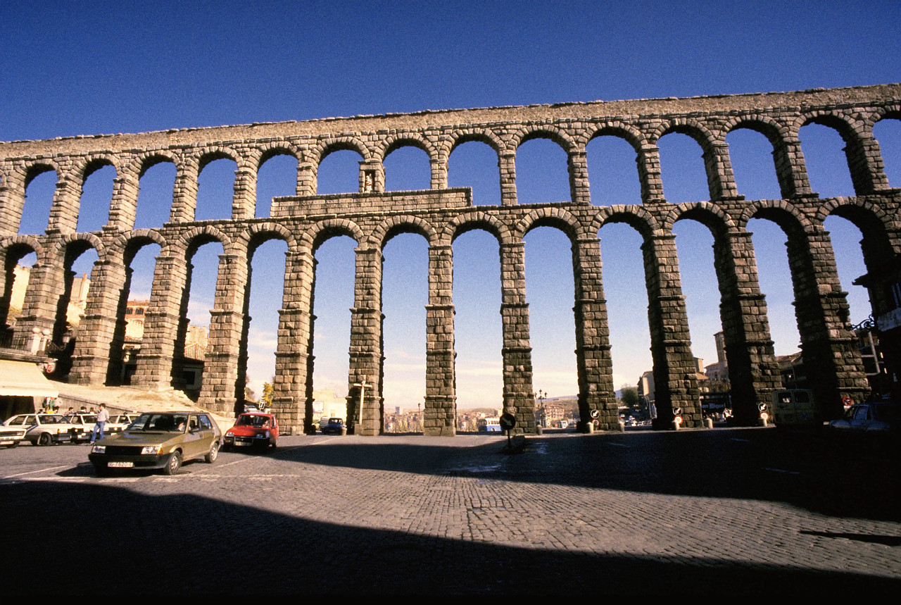
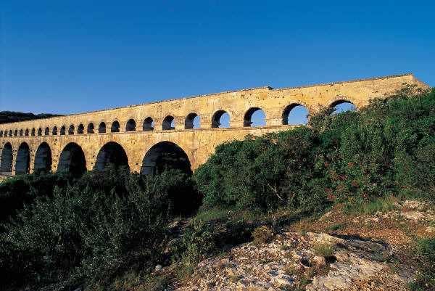
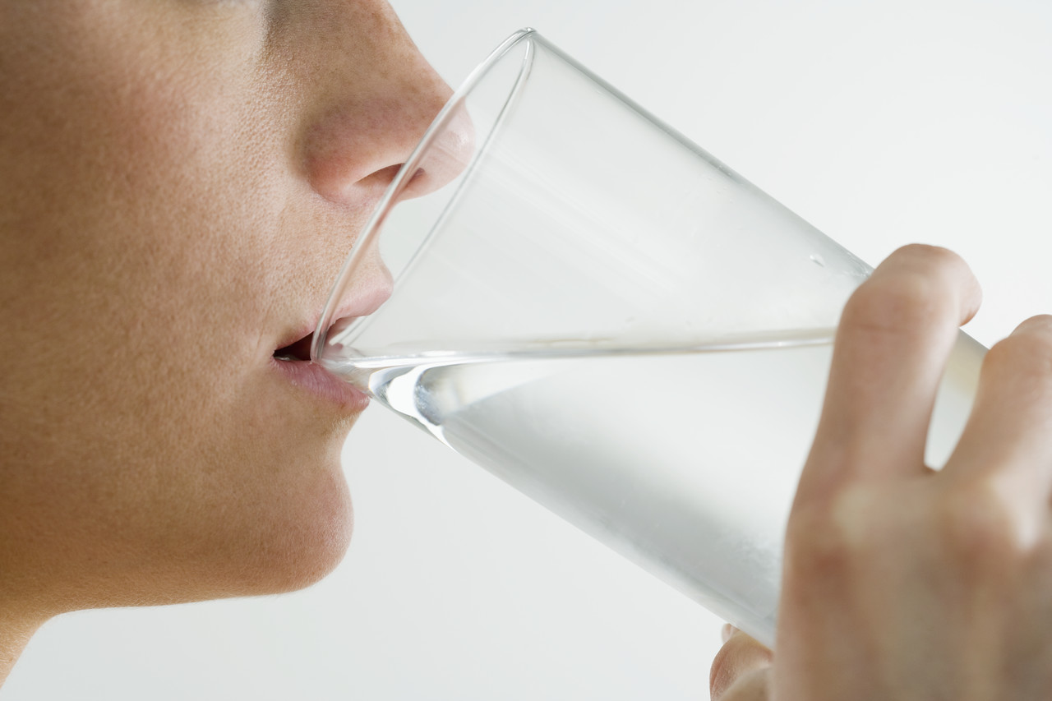
AQUEDUCTS- H20 TO THE CITY AND THE FARMS

Slide 25
THE DECLINE OF THE ROMAN EMPIRE
DECLINING AGRICULTURE
INFLATION
HEAVY TAXES
STARVING PEOPLE

Slide 26
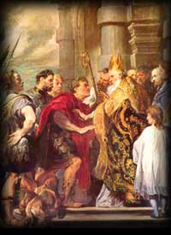
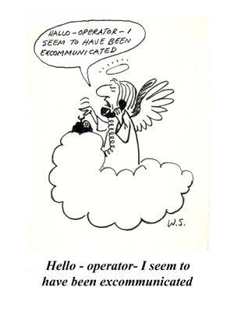
EXCOMMUNICATED
SORRY NO SACRAMENTS FOR YOU

Slide 27
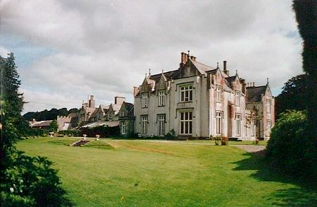
NOBLE LANDS
NOT A CASTLE
NOT A VASSAL
WATCH OUT FOR THE MOOOAT!!!
IT’S CALLED A MANOR

Slide 28
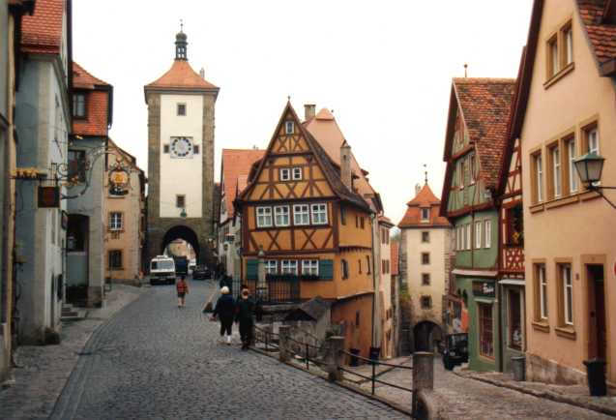
MEDIEVAL TOWNS WERE SMALL, QUAINT, & SMELLED GREAT
REALLY THEY WERE CROWDED
STREETS WERE NARROW, DARK AND SCARY!!!

Slide 29
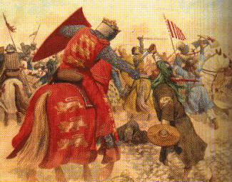
THE CRUSADES
THE CRUSADES WERE HOLY MISSIONS TO SAVE THE HOLY LAND FROM THE TURKS
THE TURKISH MUSLIMS WERE CALLED INFIDELS

Slide 30
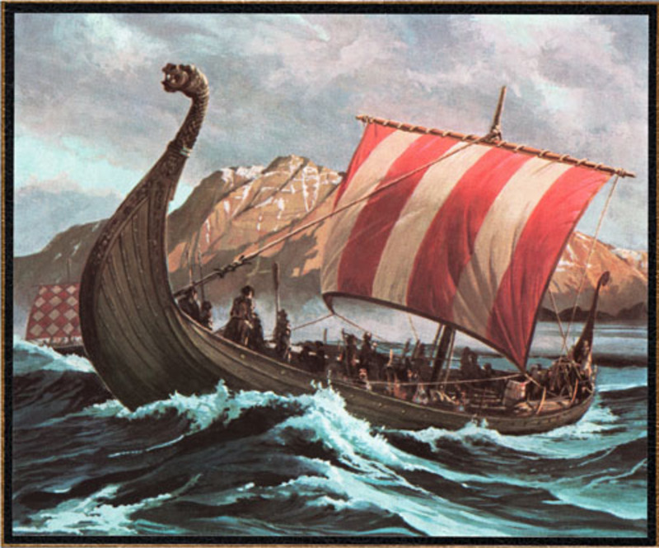
V
I
K
I
N
G
LONGSHIPS USED FOR ATTACKING ENEMY SHORES.

Slide 31
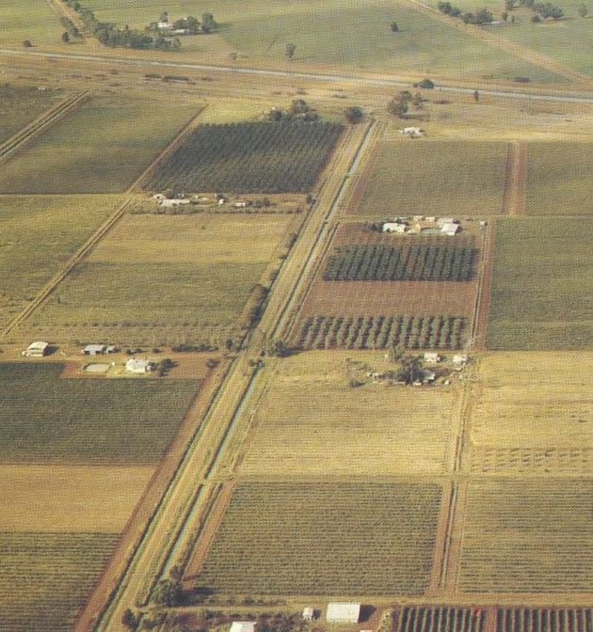
The late Middle Ages
Land = power Now Money = power

Slide 32
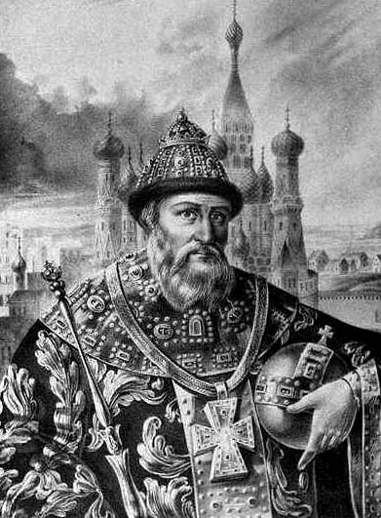
IVAN IV of RUSSIA
GRANDSON OF Ivan the Great
Known as Ivan the extremely unfriendly and not so nice
Ivan the Terrible

Slide 33
MUSLIMS
RELIGIOUS CAPITAL IS MECCA
PRAY 5 TIMES A DAY
MUST MAKE A PILGRIMAGE 1 TIME IN THEIR LIFE TO MECCA

Slide 34
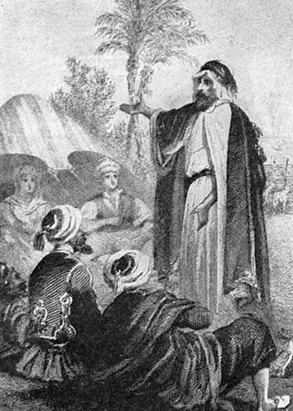
THE RELIGION OF ISLAM IS LEAD BY
MUHAMMAD
BUT ALL ARE EQUAL SO NO PRIESTS ARE IN CHARGE

Slide 35
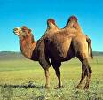
BERBERS
NOT BARBERS
SAHARAN DESERT WAS TOUGH TO CROSS
THE BERBERS USED CAMELS TO EXPAND TRADE

Slide 36
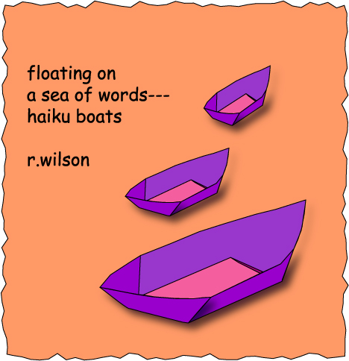
HAIKU
JAPANESE POETRY
CERTAIN SYLLABLES IN ORDER

Slide 37
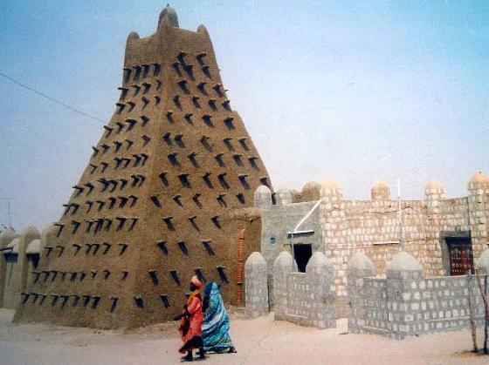
TIMBUKTU IN WESTERN AFRICA RISES UP AS
A GREAT CITY OF TRADE
LEARNING FLOURISHES AND UNIVERSITIES START

Slide 38
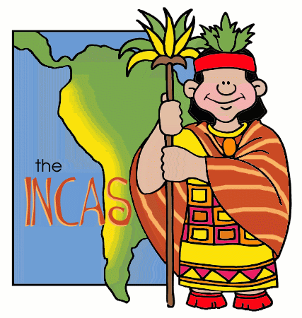
INCAS OF THE ANDES MTNS.
THE “INCA” WAS A DECENDANT OF THE SUN GOD
THEY TOOK GOOD CARE OF THEIR PEOPLE
EVERYONE WORKED FOR THE EMPIRE

Slide 39
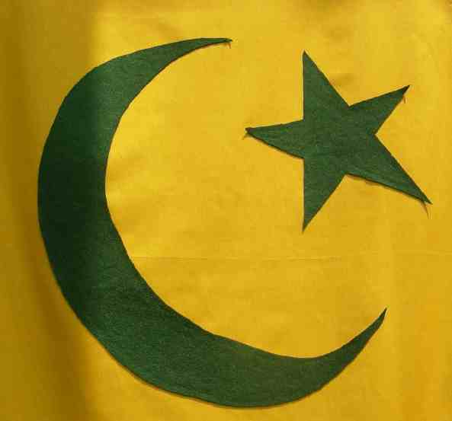

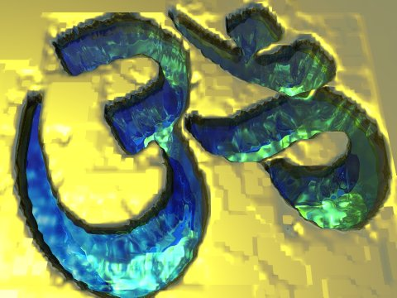
LOVE OR NOT LOVE
HINDU
MUSLIMS

Slide 40

MAYAN GODS OF

Slide 41
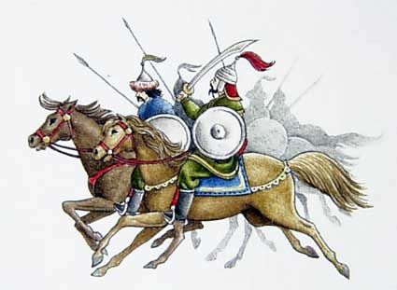
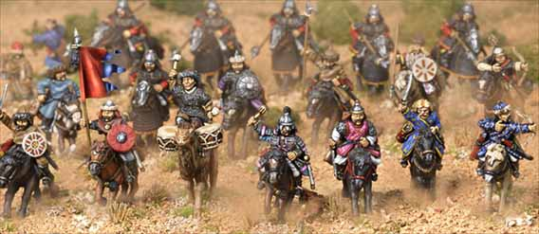
MONGOLS
GOOD HORSEBACK RIDERS
WERE FIERCE WARRIORS
REALLY LIKED THE SMELL OF FLOWERS

Slide 42
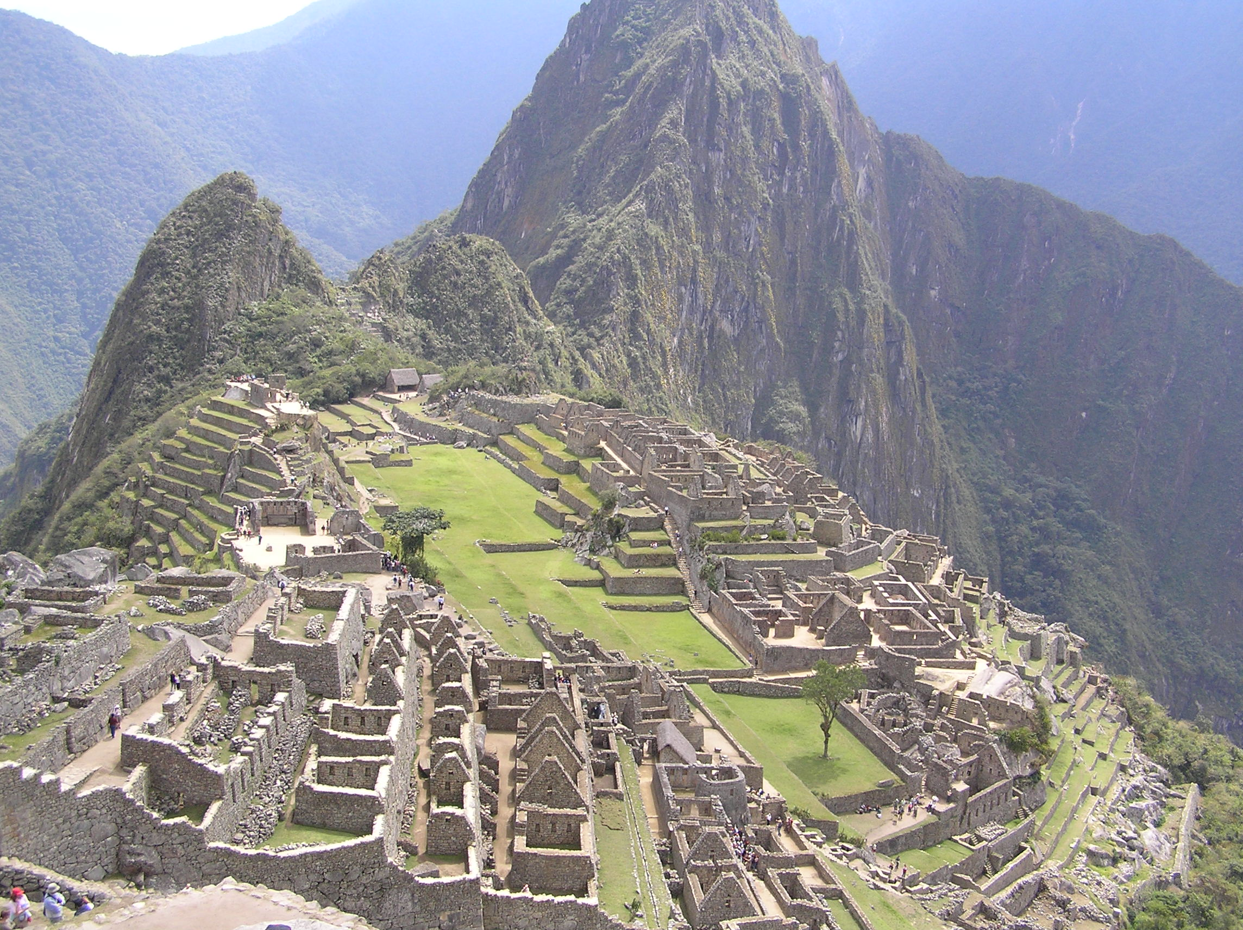
MACHU PICCHU IS A FAMOUS CITY OF THE INCAS IN PERU

Slide 43
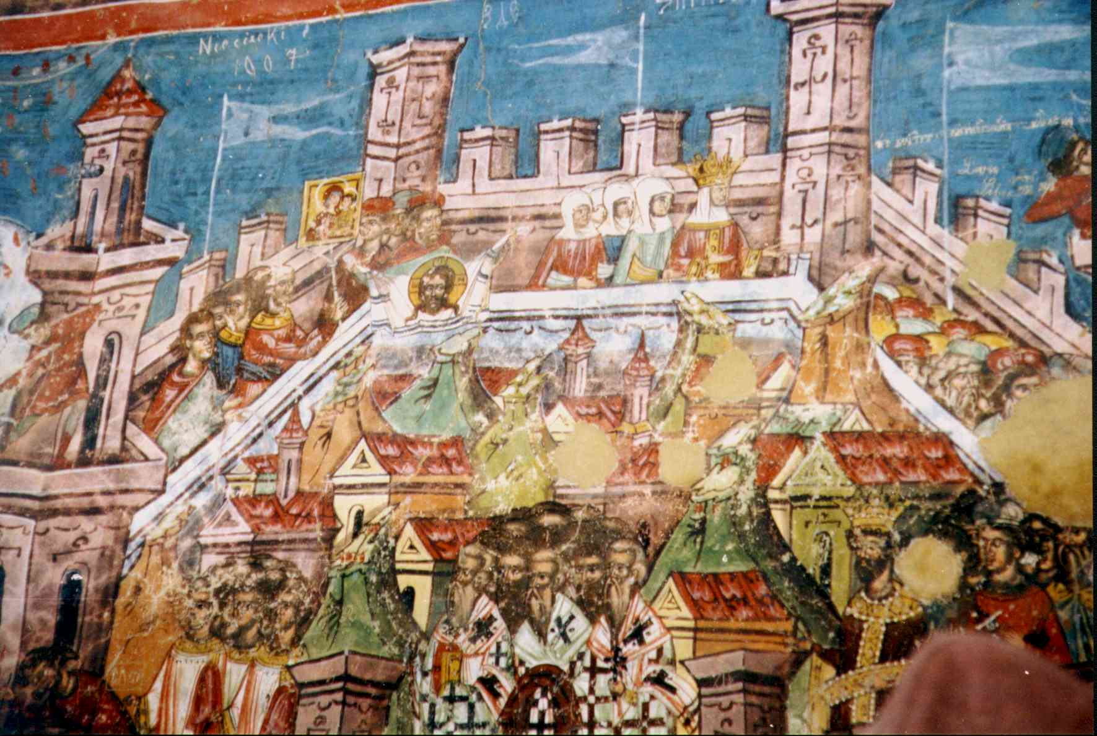
CONSTANTINOPLE
THE LAST GREAT CHRISTIAN CITY IN THE REGION
THE LAST GREAT CHRISTIAN CITY IN THE REGION

Slide 44
RENAISSANCE
REBIRTH OF CULTURE & LEARNING
STARTED IN ITALY BUT SPREAD THROUGH EUROPE
EARLY 1300’S – 1600
ART, POETRY, PAINTING, INVENTIONS

Slide 45
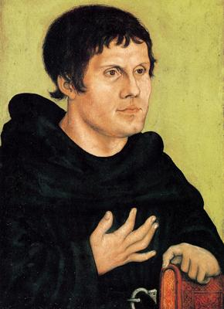
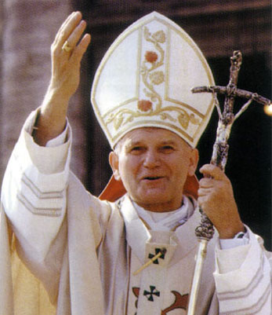
VS
MARTIN LUTHER HAS PROBLEMS WITH THE CATHOLIC CHURCH BECAUSE THEY SELL INDULGENCES TO THE RICH FOR THEIR SINS
WRITES “95 THESES” & PINS TO CHURCH

Slide 46
EXPLORATIONS
SPANISH AND PORTUGESE SEND EXPLORERS TO FIND NEW LANDS AND FASTER WAYS TO INDIA
PORTUGESE SAILORS WENT AROUND AFRICA TO ASIA

Slide 47
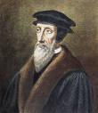
REFORMATION
PEOPLE BEGAN TO SPEAK OUT AGAINST THE POWERFUL CATHOLIC CHURCH
MARTIN LUTHER AND JOHN CALVIN ROCK!!

Slide 48

INQUISITIONS
SPANISH COURTS SET UP TO TRY HERETICS
MOORS AND JEWISH PEOPLE IMPRISONED OR KILLED
YOU BETTER BELIEVE!!!

Slide 49


PETER THE GREAT
YOU WANT THE STACHE PAY ME THE CASH!!!
NEW WESTERN INFLUENCES FOR RUSSIA

Slide 50

GERMAN TRIBES THAT INVADE MUCH OF EUROPE
VISIGOTHS

Slide 51
SCIENTIFIC REVOLUTION
OLD IDEAS ARE CHANGING
NEW IDEAS ARE TESTED WITH AN EMPHASIS ON MATHEMATICS
PASS THE EXPERIMENTS= ACCEPTED IDEA

Slide 52


JOHN LOCKE
“TWO TREATISES ON GOVERNMENT”
PEOPLE HAVE RIGHTS – LIFE, LIBERTY ETC
GOVERNMENT SHOULD PROTECT RIGHTS

Slide 53

G.W. NAMED COMMANDER IN CHIEF (JUNE 1775)
DECLARATION OF INDEPENDENCE SIGNED ( JULY 1776)

Slide 54


NEW LAWS + ALLIES = EMPIRE
NAPOLEON

Slide 55

ROUSSEAU'S SOCIAL CONTRACT
PEOPLE AGREE TO BE GOVERNED

Slide 56


A SUDDEN REVOLUTION

Slide 57

AMERICAN REVOLUTION

Slide 58

THE END
GOOD LUCK
YOU CAN DO IT!!!

Slide 59
This powerpoint was kindly donated to www.worldofteaching.com
http://www.worldofteaching.com is home to over a thousand powerpoints submitted by teachers. This is a completely free site and requires no registration. Please visit and I hope it will help in your teaching.

